Slide 1
Learning Relationships from data
Data Science for Beginners, Session 9
Notes:
Todays session is about relationships, the networks you can create from those relationships, and how to analyse those networks.

Slide 2
Lab 9: your 5-7 things:
Relationships and Networks
Network tools
Representing networks
Analysing networks
Visualising networks
Notes:
We’ve really got 4 questions here:
What is a network?
What features does a network have?
What analysis is possible with those features?
How do we explain that analysis?

Slide 3
Relationships and Networks
Notes:
Let’s start with “what is a network”. We can start by talking about nodes and edges and maths and stuff, but it’s easier to start by showing you how to identify potential networks and relationships in those networks.
If you want some network data to play with, try https://snap.stanford.edu/data/ or http://www-personal.umich.edu/~mejn/netdata/. Phonecall data can be found at http://theodi.fbk.eu/openbigdata/#portfolioModal11. If you’re interested in NYC data, try http://www.meetup.com/SocialDataNY/

Slide 4
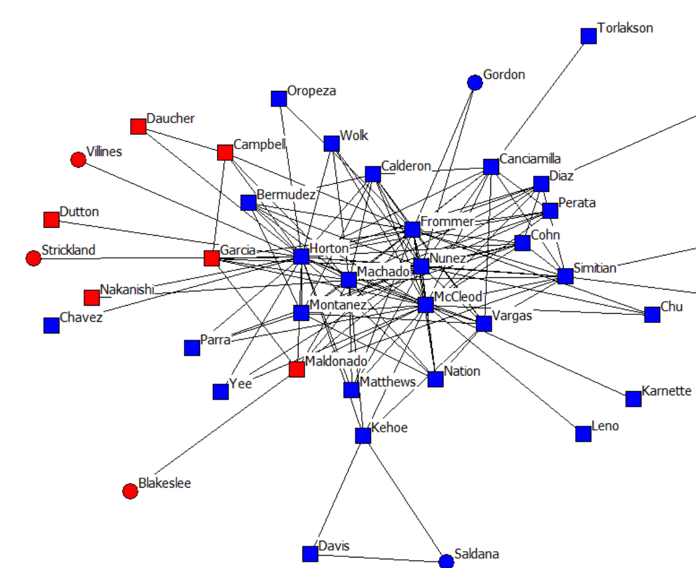
Definitions
Network: “A group of interconnected people or things”
Relationship: interconnection between two or more people or things
Node
Edge
Notes:
Quote is from the Oxford English Dictionary. Diagram is California political donations, from http://www.insna.org/PDF/Connections/v35/apkarian_web.pdf
A network is a set of things that are linked together. We use networks to understand, use and explain relationships. Networks are usually visualized as a set of points (“nodes”) connected by lines (“edges”).
A relationship can be as simple as “a ink between these two objects exists”, or as complex as “this probability matrix describes the complex relationship between the possible states of these objects”

Slide 5
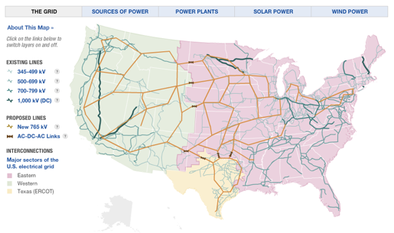
Infrastructure
Notes:
Let’s start with networks where there’s an obvious physical link. These include things like communications grids, power grids, and the movement of water supplies between streams, rivers, farms and processing plants.
As you look at these examples, I want you to think about the types of questions you could start asking with this network data. For example, in infrastructure, you often only have access to the junctions and the fact that there *is* a connection between two points. One question here might be “are there any critical links here”, e.g. if one link fails, could it break the grid, or stop an area being supplied with electricity?
Image: the main power grid in the USA, from NPR: Visualising the US Power Grid

Slide 6
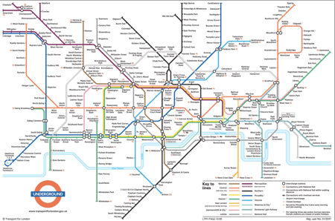
Transport
Notes:
With transport, the dataset gets richer. You not only have the nodes and links between them, you also have timetables that list the average time between stations (and the current state of the network) and the switching costs of changing lines at a station (e.g. the time taken to walk between platforms).
Image from Transport for London: London Underground Map

Slide 7
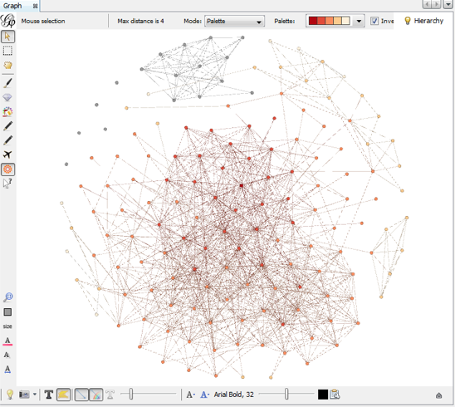
Friends
Notes:
Networks don’t have to have physical links. Here’s my Facebook network: with this, and the other networks that I connect to people with, I can also start investigating the information moving across those networks, and their effect on my state (e.g. my political opinions).
Image: Sara’s Facebook friends, visualised with Gephi.

Slide 8
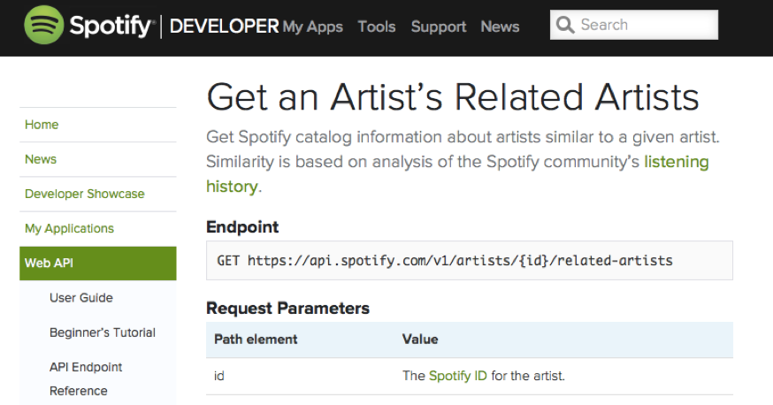
Songs
Notes:
Many datasets can be framed as networks. Here, the Spotify API gives me relationships between its artists; I can also create some of my own relationship data from this API by looking at which songs and artists are on the same playlists.

Slide 9
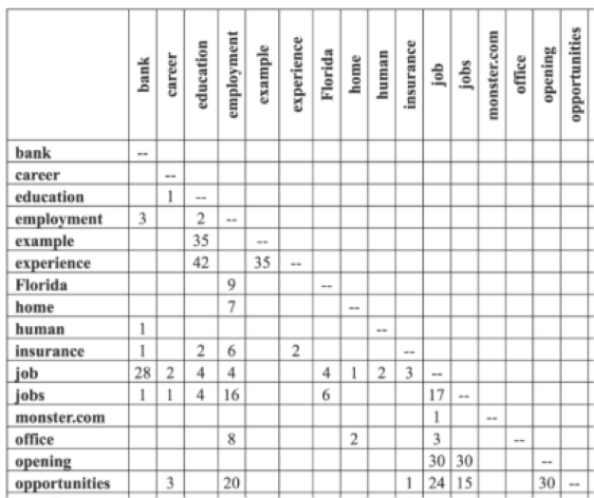
Word Co-occurrence
Notes:
Much of text analysis can also be framed as networks. Here’s a matrix showing words that occur together in sentences and how many times they’ve co-occurred in the dataset. If we see every words as a node, and every nonzero co-occurrence score as a link, we’ve got ourselves a network. This can also be applied at the document level, e.g. Jonathan Stray’s Overview project analysed networks of documents to find civilian deaths in the Iraq War.
We could also use this on hashtags, e.g. build a network of the hashtags that are used together.
Image: (Wise blogpost on word co-occurance matrices)

Slide 10
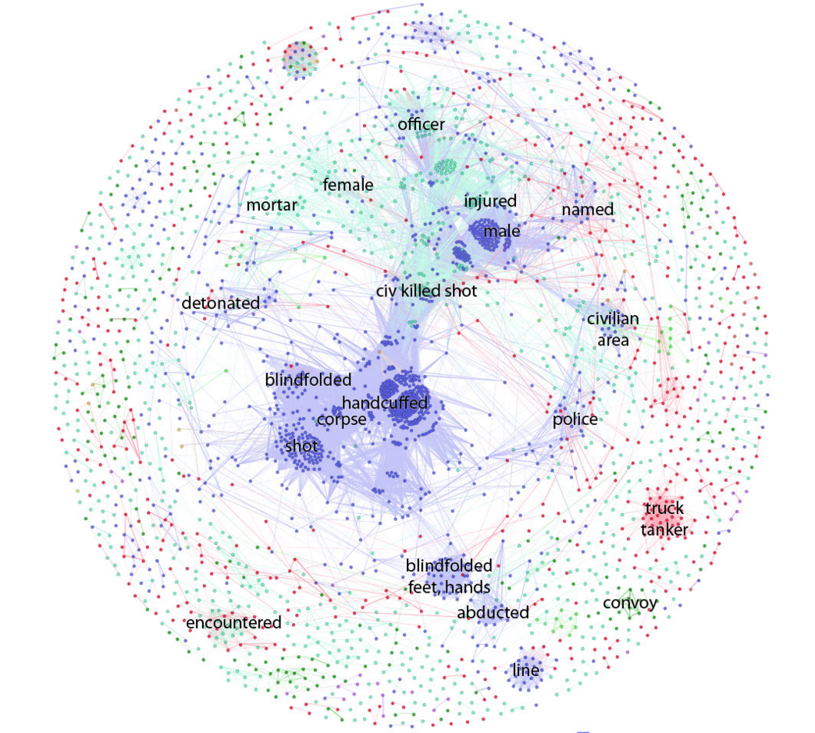
Document similarity
Notes:
Image: http://jonathanstray.com/a-full-text-visualization-of-the-iraq-war-logs - colours are types of events being described.
Documents are often clustered using latent dirichlet methods; this is what’s being used on the Panama papers right now.

Slide 11
Network Tools

Slide 12
Network tools
Standalone tools:
Gephi
GraphViz
NodeXL (Excel!)
NetMiner
Python libraries:
NetworkX
Matplotlib
Notes:
Longer list: http://en.wikipedia.org/wiki/Social_network_analysis_software

Slide 13
Representing Networks

Slide 14
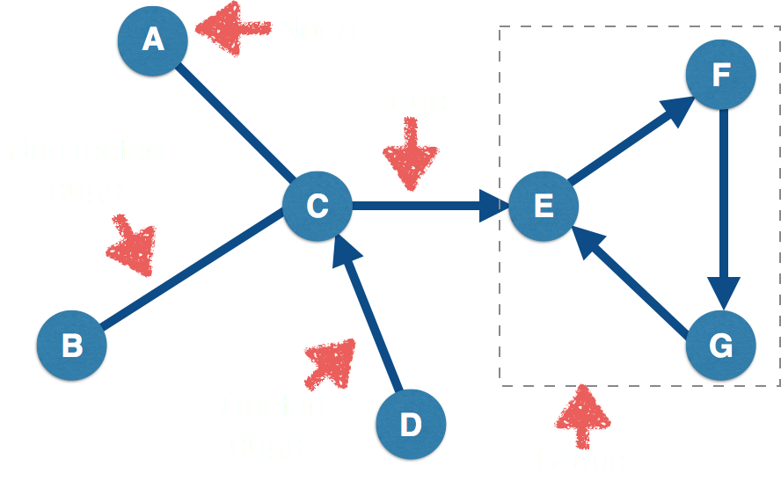
Network “features”
Notes:
We’re going to be dealing with simple networks. These each have features, that we need to be able to name.
Node: object in the network (e.g. two people)
Edge: link between two objects (e.g. a friendship)
Directed edge: link for a relationship that just goes one way (e.g. a ‘friends’ b, but b doesn’t ‘friend’ a).
Clique: set of nodes where every node in the clique is connected every other node in the clique.

Slide 15
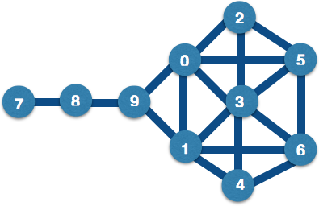
Network Representation: diagram
Notes:
We’re going to look at the same network, using all the different ways that network tools could represent it. First up: a diagram, basically a visualisation of all the network’s node and links. Diagrams are good for explaining a network (and can be interactive)

Slide 16
Adjacency Matrix
[[ 0, 1, 1, 1, 0, 0, 0, 0, 0, 1],
[ 1, 0, 0, 1, 1, 0, 1, 0, 0, 1],
[ 1, 0, 0, 1, 0, 1, 0, 0, 0, 0],
[ 1, 1, 1, 0, 1, 1, 1, 0, 0, 0],
[ 0, 1, 0, 1, 0, 0, 1, 0, 0, 0],
[ 0, 0, 1, 1, 0, 0, 1, 0, 0, 0],
[ 0, 1, 0, 1, 1, 1, 0, 0, 0, 0],
[ 0, 0, 0, 0, 0, 0, 0, 0, 1, 0],
[ 0, 0, 0, 0, 0, 0, 0, 1, 0, 1],
1, 1, 0, 0, 0, 0, 0, 0, 1, 0]]
Notes:
An adjacency matrix is an n by n grid, with 1 row and 1 column for each network node, a “1” everywhere a link exists, and a ‘0’ everywhere else. Adjacency matrices are good for representing dense graphs (i.e. graphs with lots of links between nodes).
You can also represent ‘sparse’ graphs using an adjacency matrix, but these will have lots and lots of zeros in them. The Python scipy.sparse library is useful is you want to represent very large sparse matrices, without taking up huge amounts of memory.

Slide 17
Adjacency List
{0: [1, 2, 3, 9],
1: [0, 9, 3, 4, 6],
2: [0, 3, 5],
3: [0, 1, 2, 4, 5, 6],
4: [1, 3, 6],
5: [2, 3, 6],
6: [1, 3, 4, 5],
7: [8],
8: [9, 7],
9: [8, 1, 0]}
Notes:
An adjacency list is a list of a the nodes, with a list of all the nodes connected to each of them.
An adjacency list is good for representing sparse graphs (e.g. social networks tend to be sparse), and is the main network representation used by NetworkX.

Slide 18
Edge List
{(0,1), (0,2), (0,3), (0,9),
(1,3), (1,4), (1,6), (1,9),
(2,3), (2,5), (3,4), (3,5), (3,6),
(4,6), (5,6), (7,8), (8,9)}
Notes:
An edge list is a list of all the connections between nodes. This is a good general network representation.
You’ll also find networks described in mathematical terms, e.g. as “G = (V,E,e)” where G is the network (‘graph’), V are the nodes (‘vertices’); E are the edges and e is the relationship (‘mapping’) between edges and nodes. Networks are covered by areas of maths that include Graph Theory.

Slide 19
NetworkX: Python network analysis library
import networkx as nx
edgelist = {(0,1), (0,2), (0,3), (0,5), (0,9), (1,3), (1,4), (1,6), (1,9), (2,3), (2,5), (3,4), (3,5), (3,6), (4,6), (5,6), (7,8), (8,9)}
G = nx.Graph()
for edge in edgelist:
G.add_edge(edge[0], edge[1])
Notes:
So let’s try some of this. NetworkX produces ugly graphs, but has a good set of network analysis tools.
(NB if you want a directed graph, use nx.DiGraph() )

Slide 20
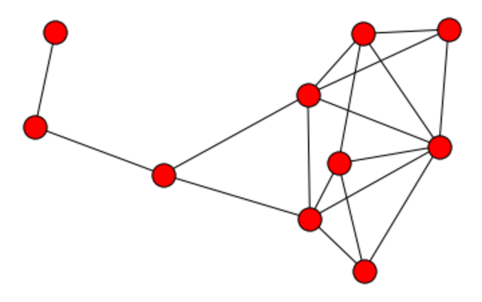
NetworkX diagrams
import matplotlib.pyplot as plt
%matplotlib inline
nx.draw(G)
Notes:
Here’s NetworkX’s visualisation of that graph. When humans draw graphs, they generally think about where to put the nodes, minimise the number of links crossing over each other, make them pretty. Computers don’t think that way, so don’t be surprised if NetworkX draws something that doesn’t look, on the surface, anything like your graph. “Making it pretty” is one of the reasons that we use packages like Gephi to visualise graphs (another is “make it easier to spot patterns in this graph”).

Slide 21
Network Analysis

Slide 22
Network Analysis
Centrality: how important is each node to the network?
Transmission: how might (information, disease, etc) move across this network?
Community detection: what type of groups are there in this network?
Network characteristics: what type of network do we have here?

Slide 23
Power (aka Centrality)

Slide 24
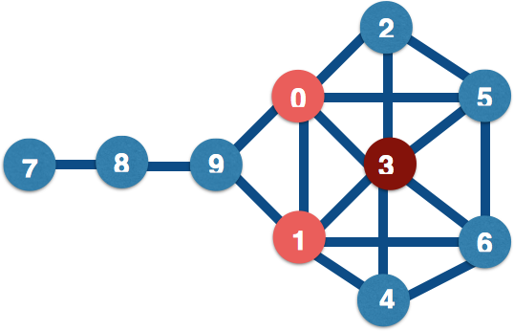
Degree Centrality: who has lots of friends?
nx.degree_centrality(G)
3 0.666
0 0.555
1 0.555
5 0.444
6 0.444
2 0.333
4 0.333
9 0.333
8 0.222
7 0.111
Notes:
Centrality is all about power. And there are different types of power. The simplest form of centrality is degree centrality, e.g. how many links connect directly to each node.
NetworkX centrality functions are here: http://networkx.lanl.gov/reference/algorithms.centrality.html Note that degree centrality is normalized (divided) by the largest possible number of connections per node: in this case, 9.
Degree centrality is not a great measure of power: a more important measures may be the number of nodes that each node can easily reach, and it’s possible that the highest-ranked node by degree centrality is part of a clique that’s not well connected to the outside world.

Slide 25
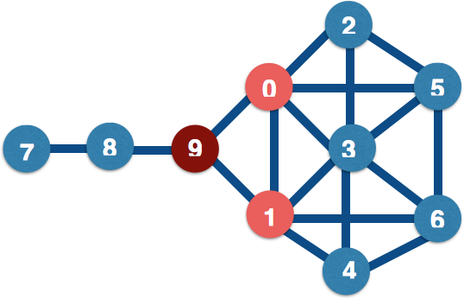
Betweenness centrality: who are the bridges?
nx.betweenness_centrality(G)
9 0.38
0 0.23
1 0.23
8 0.22
3 0.10
5 0.02
6 0.02
2 0.00
4 0.00
7 0.00
Notes:
Between = how many nodes are there between two nodes?
Nodes with high betweenness have influence over the flow of information or goods through a network: they bridge separate communities (good) but also often are a single point of failure in communications between those communities (bad).
Betweenness = (number of shortest paths including n / total number of shortest paths) / number of pairs of nodes

Slide 26
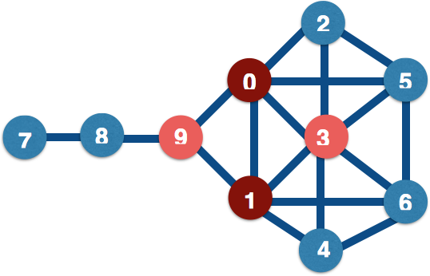
Closeness centrality: who are the hubs?
nx.closeness_centrality(G)
0 0.64
1 0.64
3 0.60
9 0.60
5 0.52
6 0.52
2 0.50
4 0.50
8 0.42
7 0.31
Notes:
Closeness = has the shortest average path to all other nodes in the network. Nodes with high closeness have great influence over the rest of the network, especially if influence diminishes with path length; these points are also good places to observe all information flows from.
Closeness = sum(distance to each other node) / (number of nodes-1)

Slide 27
Eigenvalue Centrality: who has most influence?
nx.eigenvector_centrality(G)
3 0.48
0 0.39
1 0.39
5 0.35
6 0.35
2 0.28
4 0.28
9 0.19
8 0.04
7 0.01
Notes:
Eigenvector centrality measures how much influence a node has in the whole network, taking account of their connections to other highly-connected nodes. These are the “kings” of your network - they might not have great closeness or betweenness, but they do wield a lot of influence. The algorithm behind Google search, PageRank, is based on eigenvector centrality.
NB Eigenvector centrality algorithms are complex, and won’t always give you a solution.

Slide 28
Transmission (aka Contagion)
Notes:
Contagion models predict how information or states (e.g. political opinion or rumours) are most likely to move across a network

Slide 29
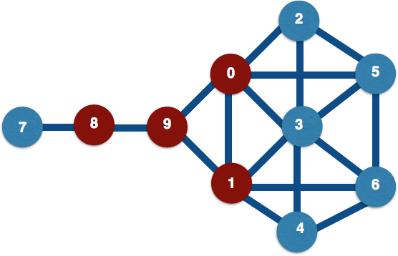
Simple contagion: always transmit
Notes:
Simple contagion (aka diffusion) models are used when it’s important that you find *everybody* in contact, e.g. for Ebola, you have to assume that everyone an infectious person is in contact with is a potential carrier. Here, we assume that node 9 changes state first; in the next step of the algorithm, the nodes directly connected to it (0,1,7) change state; in the next step, the nodes connected to (0,1,7) change state, etc. etc.
Thought experiment: infections are time-sensitive, e.g. you get infected, then either get better or die. How would you represent this in a network? What would you expect to happen in a small-world network?

Slide 30
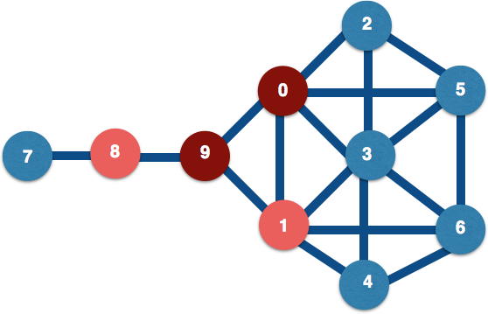
Complex Contagion: only transmit sometimes
Notes:
Complex contagion are diffusion models for more complex choices, e.g. whether to go see a movie, based on your friends’ opinions plus reading movie reviews.
In complex contagion, a node changes state based on the state of *all* its neighbors, and often also on outside information; just because 9 is in one state, 1 doesn’t have to change to that state too (but it might change state with probability p).

Slide 31
Community Detection
Notes:
Let’s look at communities: groupings within your network. These are useful for questions like “how is a network likely to split into groups” and “how do I efficiently influence this network”. Note that when we have a community, we can study it as a network in its own right, including finding the most important nodes in it.
“Small world theory” = there are roughly 6 steps on the shortest path between each pair of nodes in the world (see also “6 degrees of Kevin Bacon” http://en.wikipedia.org/wiki/Six_degrees_of_separation). The maths works out at roughly s = ln(n)/ln(k) where n is the population size and k is the average number of connections per node. For k=30, s is usually roughly 6.
NetworkX community functions: http://networkx.lanl.gov/reference/algorithms.community.html

Slide 32
Cliques and Cores
nx.find_cliques(G)
nx.k_clique_communities(G, 2)
Notes:
These are group measures based on the numbers of links. The K-core is defined as: Every node in the clique is connected to K or more other nodes in the clique.
Clique-level analysis and node-level analysis interact with each other, e.g. if you find a set of cliques in a network, you can then look for and use the central nodes in those cliques.
In this graph, the largest cliques have 4 nodes in them: for instance, the nodes in the pink box are all connected to each other. There are two 4-cliques in this diagram ([[0,2,3,5],[1,3,4,6]]), two 3-cliques: [[0,1,3],[0,1,9]], and two 2-cliques: [[7,8],[8,9]]. The largest k-cores is a 2-core, with the green box around it: [0,1,2,3,4,5,6,9].
K-cores and cliques don’t always find the natural cliques in a graph (especially one containing human relationship). N-cliques: “friend of friend” cliques; use Bron and Kerbosch algorithm. Issues include nodes that contribute to the clique aren’t included in it. P-clique addresses some of this. Other approaches: n-clans, k-plexes etc.: see http://faculty.ucr.edu/~hanneman/nettext/C11_Cliques.html#nclique

Slide 33
Network Properties

Slide 34
Network Properties
Characteristic path length: average shortest distance between all pairs of nodes
Clustering coefficient: how likely a network is to contain highly-connected groups
Degree distribution: histogram of node degrees
Disconnection
Notes:
Social networks = short path lengths, high clustering, skewed degree distributions.
Small worlds = lots of highly-connected small groups with fewer connections to other groups: Saw this effect in the Ebola response contact-tracking.
All available in networkx
Disconnected networks are networks where there isn’t a path from every node to every other node in the network. These networks can be interesting because of the lack of connections between groups (e.g. you’re trying to most efficiently connect up different transport systems). These can be described by their “components”, e.g.
Connected component = every node in the component can be reached from every other node
Giant component = connected component that covers most of the network

Slide 35
Network Visualisation

Slide 36
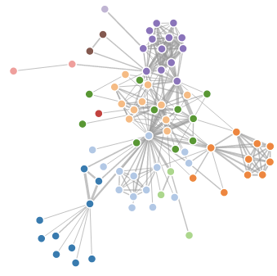
Node-Link Diagram
Notes:
Node-link diagrams are still the best way to describe networks. Most of the network tools will produce one of these. This is a D3 force-directed visualisation (bl.ocks.org/mbostock/4062045 : Les Miserables character relationships). Force-directed graphs try to produce a clean network visualisation by treating the network as though the nodes are pulling outwards with the links pulling them back; Gephi is also good for these.
Explaining graphs to the C-suite? Use visual cues they’re used to. Carefully. Some examples are in the Visualisation Periodic Table at http://www.visual-literacy.org/periodic_table/periodic_table.html

Slide 37
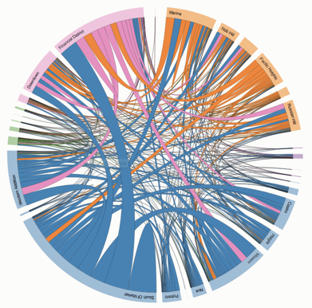
Edge Bundling
Notes:
Edge bundling is useful for small world networks. This is another d3 diagram (http://bost.ocks.org/mike/uberdata/ : Uber rides by neighbourhood); another D3 example is here: http://bl.ocks.org/mbostock/7607999

Slide 38
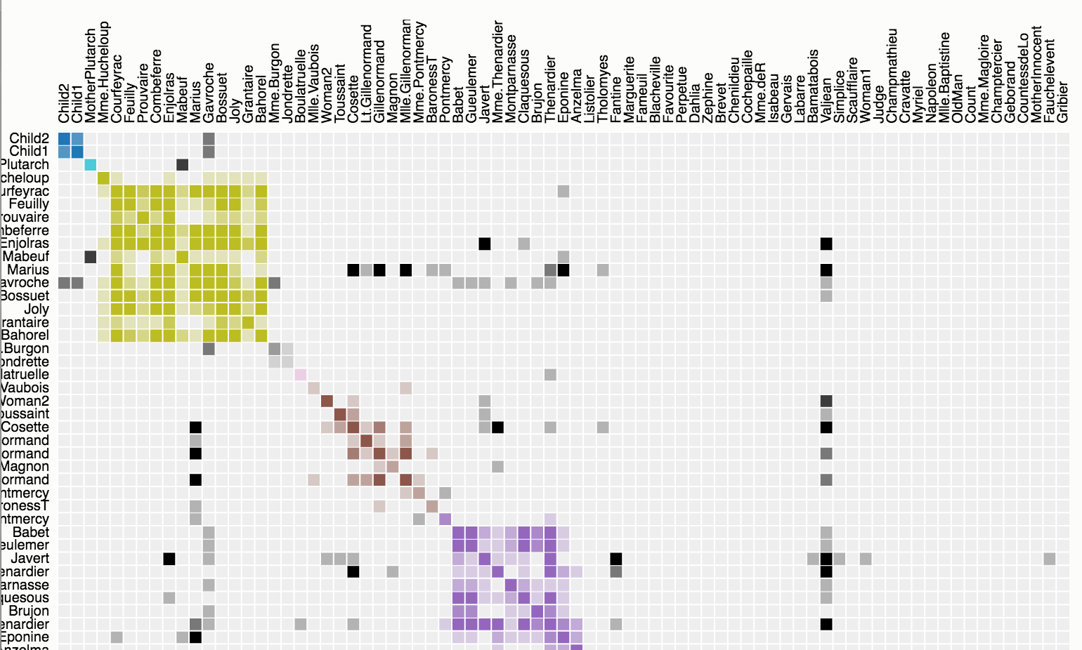
Adjacency Matrix
Notes:
An adjacency matrix can help if it’s nicely grouped, but sometimes it’s just more confusing. Metanodes (a network where each node is a group of smaller nodes) are useful for large networks of communities.
Image: https://bost.ocks.org/mike/miserables/
A heavy but useful post on network visualisation is http://www.cmu.edu/joss/content/articles/volume14/ChuWipfliValente.pdf

Slide 39
Exercises

Slide 40
Try this on your own data!
Notebook 10.1 has code for this session. It’ll work on most network data.

